Slide 1

Interrupts in Embedded
Systems

Slide 2
A general outlook of interrupts
Interruptions, are familiar enough in daily life. Let’s look at a typical example: you’re reading a book in your living room, but you’re also expecting a delivery sometime during the day. Suddenly the doorbell rings, alerting you that your delivery is here. Now just replace the words “you” with “MCU,” “doorbell” with “interrupt signal,” and “delivery” with “event,” and it’s all so clear. This is called an interrupt
Now assume that you are reading the book and waiting for the delivery, but you don’t have a doorbell and the delivery person has agreed to quietly drop the package off at your door. (In other words, you won’t be interrupted.) In this case, you would stop reading from time to time and go to the door to see if the package has been reached. In the MCU world, this type of periodic checking—the alternative to interrupts—is called polling.

Slide 3
Polling
The microcontroller constantly checks for the state of an input pin inside a loop without continuing any other operation.
When the state of the pin satisfies the condition, the corresponding task is performed.
while(1)
{
if(condition)
{
//task
}
}
The disavantage is that no other task can be done while the MCU is cheking for the status of input pin.

Slide 4

What is an Interrupt?
It is something that allows you to interrupt the current running code in order to perform another action, and once done resume the function that it interrupted.
But why do we need it?
Micro controllers interact with the physical world. The physical world is unpredictable, events happen at random intervals and sometimes they have to be dealt with right away to prevent hardware damage or data loss.

Slide 5
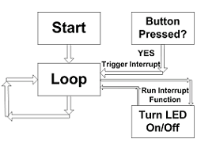

Slide 6
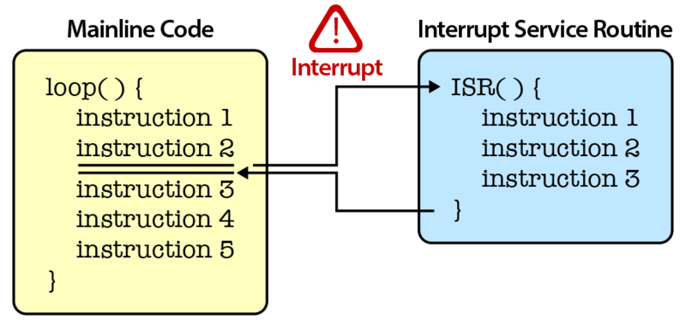
Interrupt Service Routine(ISR)
The part(block) of the program that contains the commands to be executed when interrupt request.

Slide 7
Now we have 2 questions for you!!
If two different commands are to be executed when two different conditions are met how will you write the commands?
If two or more interrupt requests are triggered at the sametime which one will get executed first?
Notes:
7

Slide 8
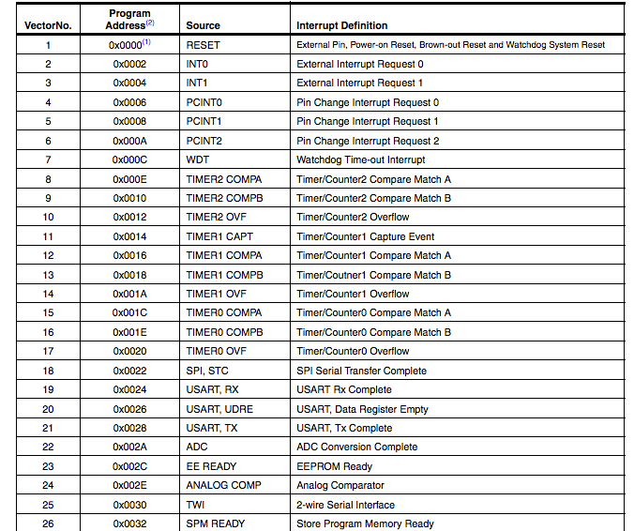
This image holds the answer for both these questions!
Interrupt vector table

Slide 9
We use the specific ‘vector’ name for the interrupt to specify the commands to be executed during the respective interrupt request
If two or more requests are triggered at the same time the order given in the table is followed.
Ex: If suppose INT0,INT1 and reset are triggered,this order is followed,
Reset
INT0
INT1

Slide 10
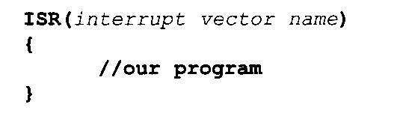
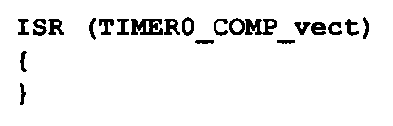
Syntax for interrupt definition
Example:

Slide 11
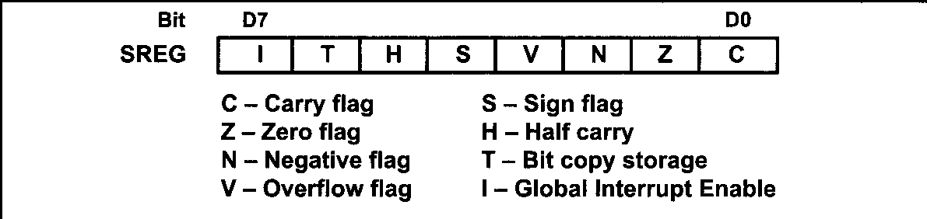
Enabling and disabling interrupts
Firstly, globally enable all interrupts
This is done by setting I bit of SREG register.
Setting it up high can be done by in-built function
sei();
Similarly , clearing it is done by cli();

Slide 12
Flag Registers for interrupts
Every interrupt will have a corresponding flag register associated with it
These registers will have a corresponding input which is set to one when interrupt is triggered
This bit is reset (zero) whenever the Interrupt Service Routine (ISR) is executed. If there is no ISR to execute, we can clear it manually by writing one to it.

Slide 13
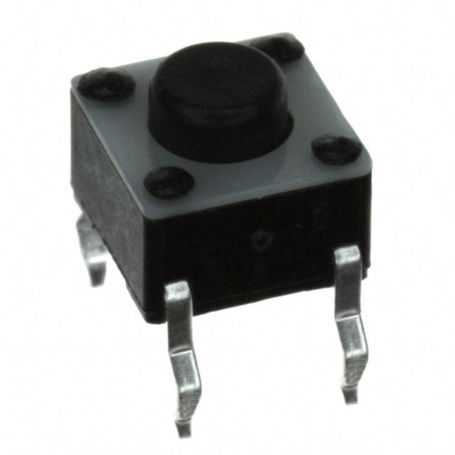
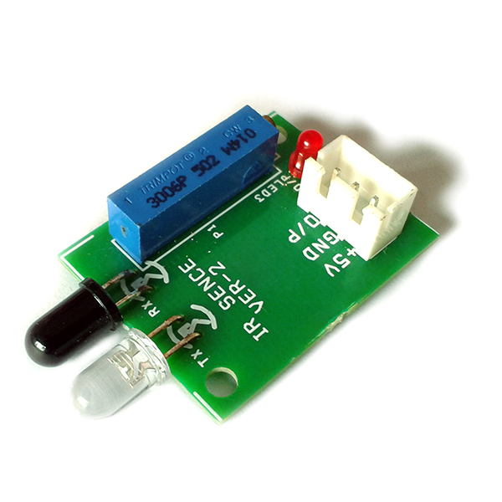
External interrupts
One of the important types of interrupts is the external interrupt
It is one of the important ways where we can control the functioning of the microcontroller externally.
It can be triggered using a tactile switch(push button), IR modules etc.
Tact switch (push button)
IR module

Slide 14
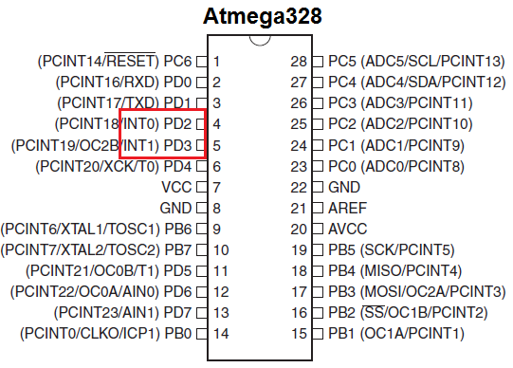
External interrupt in Atmega 328
The two shown pins PD2(INT0) or PD3(INT1) can be used to trigger the external interrupt

Slide 15

How to go about enabling external interrupt
1)Globally enable interrupts by sei();//As discussed before.
2)Set External Hardware Interrupt Enable bit(INTx) in EICR (External Interrupt Control Register) .
3) #### A very important note#####
When using external interrupt, the above pins should be in input mode.
EICR

Slide 16

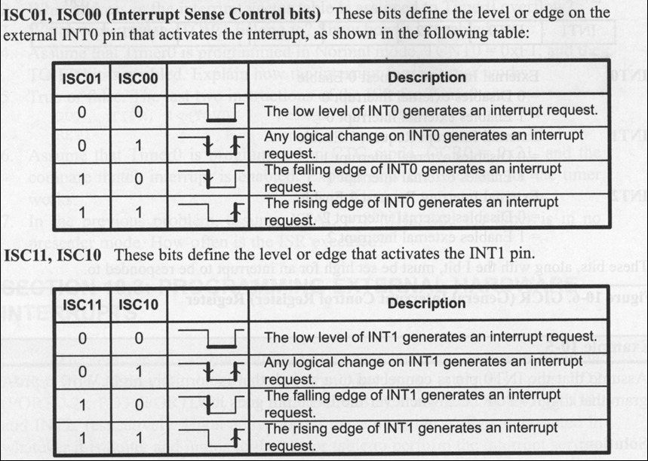
3) Specify whether interrupt signal should be generated on rising or falling edge or either of them or even low level triggered by giving appropriate values to ISCxx bits of EICRA(External Interrupt Control Register A).
4) Finish by completing the ISR with appropriate vector name

Slide 17
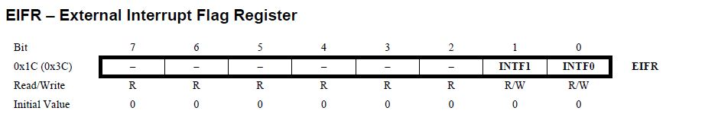
Flag register for External interrupts
As mentioned earlier, external interrupts have their associated flag register
When the event specified by the Interrupt Sense Control (ISCxy) bits in the MCU Control Register (MCUCR) is sensed on the INTx pin, the External Interrupt Flag x (INTFx) in the External Interrupt Flag Register (EIFR) is set HIGH (1).
If the I-bit in SREG and the INT1 bit in the GICR are both HIGH(1) the MCU will jump to the corresponding vector. The Flag is set to LOW (0) when the INTx_vect routine is executed.

Slide 18
